Slide 1

Home automation
CS225 – CS226 PROJECT
NAME : ARIHANT K R
ROLL NO : 1901CS09

Slide 2
INTRODUCTION
In this project ,we look into how we can automate the electronic appliances or several other normal instruments and functions using Arduino(NODEMCU ESP8266 board) as a major tool along with several other supporting equipments at home or any other workspace remotely through the usage of internet(WAN) and a web client providing us the MQTT service which enables us to automate any electronic appliance or perform any function connected to the Nodemcu board from any part of the world.
WHY THIS PROJECT?
The technique of remote automation used in this project ,holds a wide significance in the modern day world, based on which a lot of current day modern functions perform on themselves without any regular action required to be performed over them and also intimates us about any mishap that’s occurring or going to at some remote part of the world.
Ex:- A self automated regular performance of a Traffic Light System which performs and responds as time passes by without any continuous action required by anyone.
We will look into a prototype of it about how it can be remotely automated in this project.

Slide 3
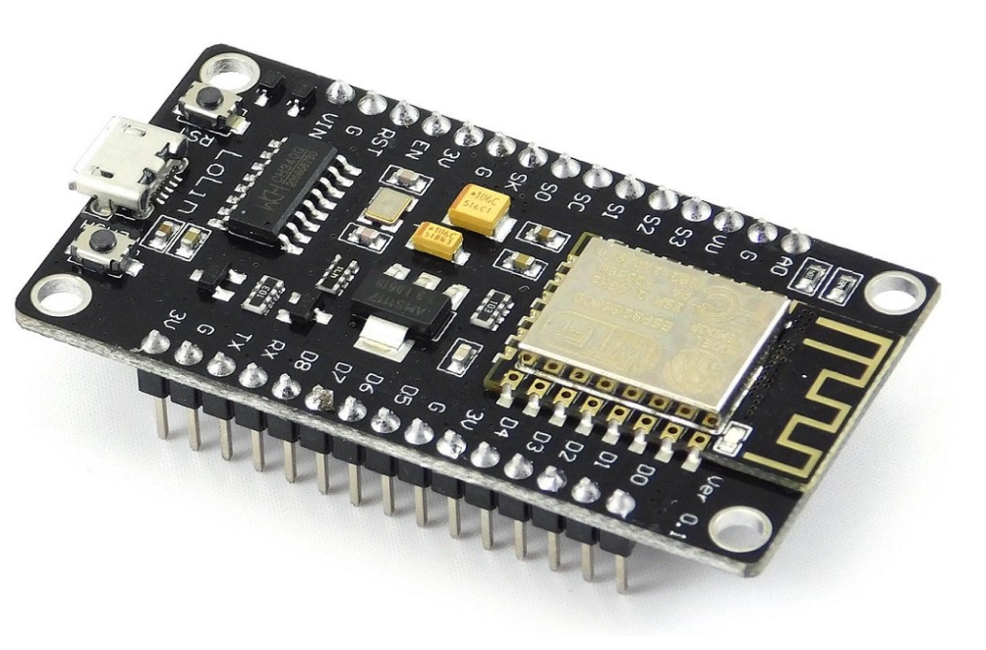
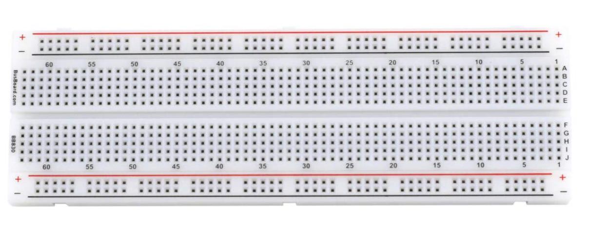
COMPONENTS USED IN THE PROJECT
1)NODEMCU ESP8266 WIFI DEVELOPMENT BOARD:- ESP8266 Arduino core is a collection of software and hardware components required by the board manager and the Arduino IDE to compile an Arduino C/C++ source file for the target MCU’s machine language. And NodeMCU is a low-cost open source IoT platform which is configured within this board specially to connect it to a LAN using wifi or to the WAN using mqtt service providers.
2)BREADBOARD:- Breadboard is used to make quick electrical connections between components like batteries, resistors, capacitors and LEDs. In our project we will use two breadboards, one for the remote automation of simple house hold appliances and to find out humidity, temperature at that location and the other for remotely automated Traffic light system prototype.

Slide 4
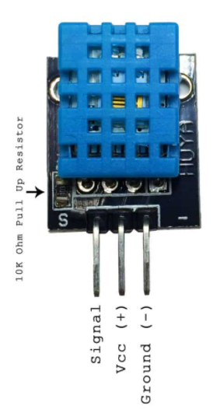
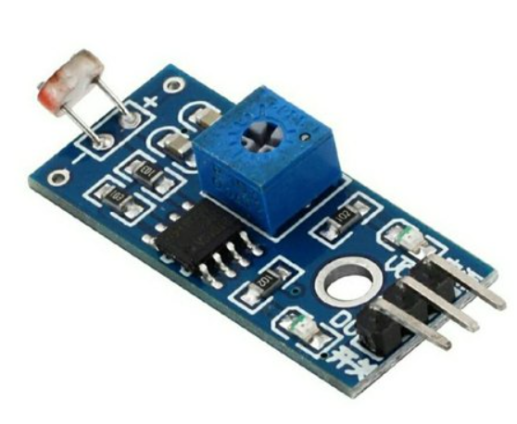
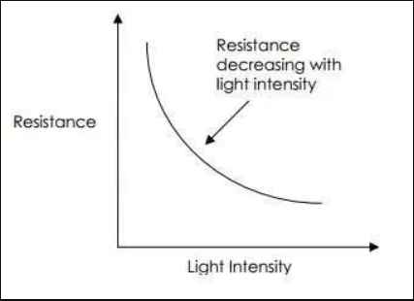
3)DHT11 SENSOR :- The DHT11 is a basic, ultra low cost digital temperature and humidity sensor. It uses a capacitive humidity sensor and a thermistor to measure the temperature of the surrounding air, and spits out a digital signal on the data pin(no analog input pins required).Its fairly simple to use, but requires careful timing to grab data. The Vcc pin and the ground pin is connected to the high voltage and the ground of the NodeMCU and the data pin to a digital signal pin of the NodeMCU board.
4)LDR SENSORS :- Photoresistors, also known as light dependent resistors(LDR), are light sensitive devices most often used to indicate the the presence or absence of light, or to measure the light intensity. The working principle of a LDR is photoconductivity, which is nothing but an optical phenomenon. When the light falls on the LDR, then the electrons in the valence band of the material excite to the conduction band and their resistance decreases as the light intensity increases: in the dark and at low light levels, the resistance of a LDR is high and little current can flow through it. The LDR sensor also has three pins the Vcc pin and ground pin connected to the high voltage and ground of NodeMCU board and the data pin connected to the analog signal pin of NodeMCU.

Slide 5
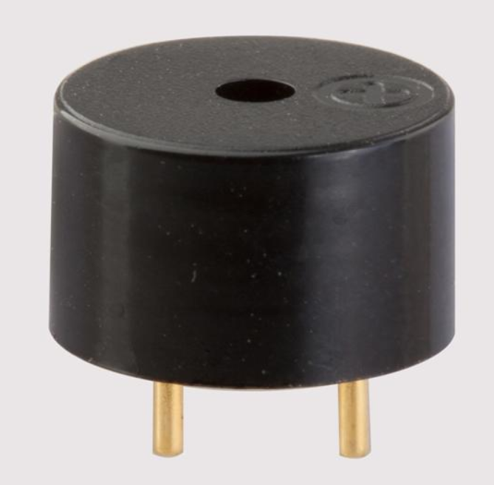
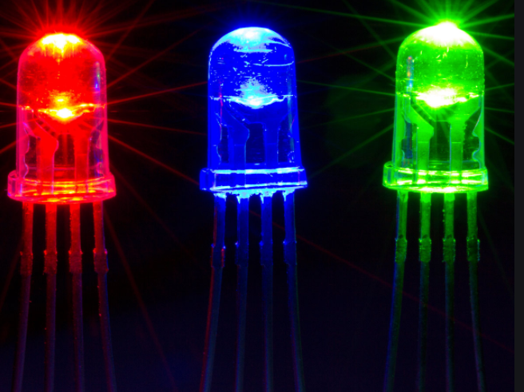
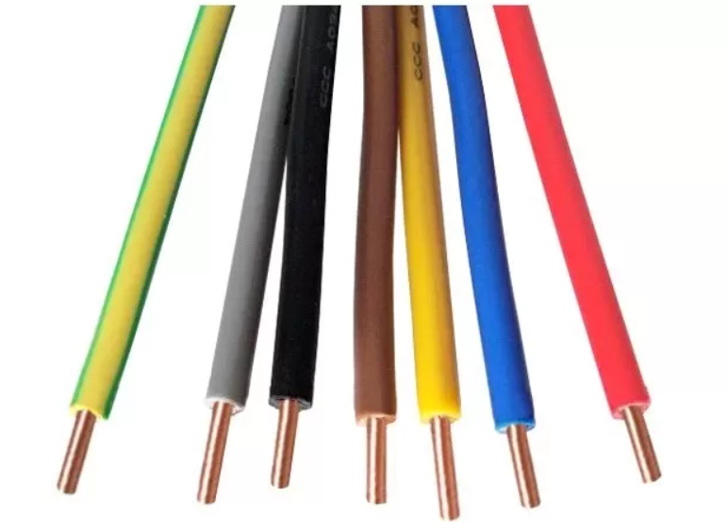
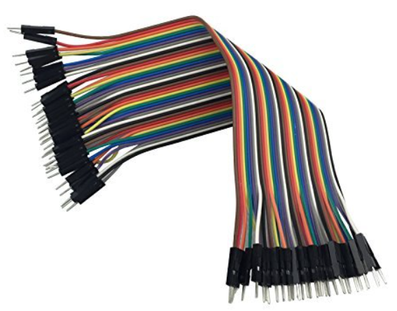
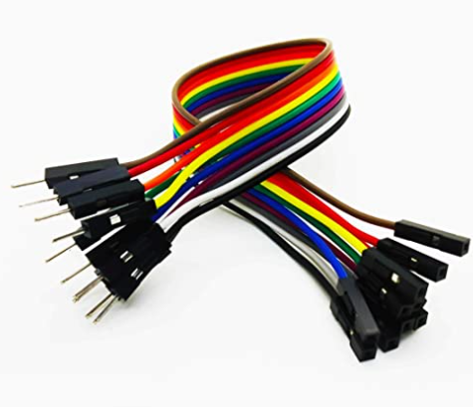
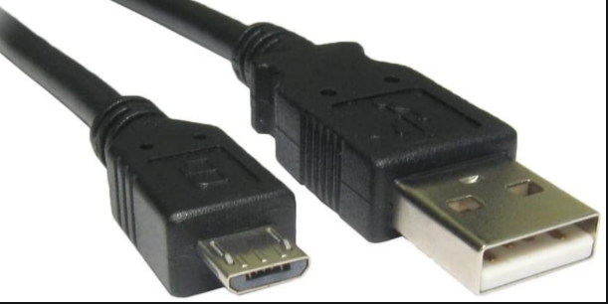
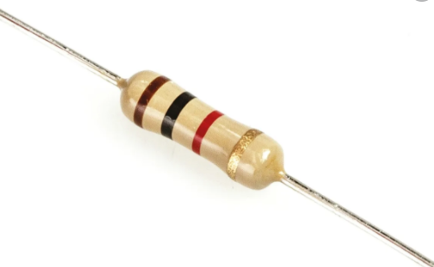
5)ELECTROMAGNETIC BUZZER :- An electromagnetic buzzer consists of an oscillator, solenoid coil, magnet, vibration diaphragm, where it produces sound through magnetism, with a frequency of 2KHz. The vibrating disk in a buzzer is attracted by the pole by the magnetic field. When an oscillating signal is moved through the coil, it produces a fluctuating manetic field which vibrates the disk at a frequency equal to that of the drive signal resulting in production of periodic sound beats.
OTHER COMPONENTS USED
LED Lights
Single Stranded Copper Wires
Male to Male Jumper Wires
Male to Female Jumper Wires
Micro USB Data Cable
Resistor

Slide 6
ABOUT THIS PROJECT
This project is chiefly divided into three important parts which has a wide range of real life applications in the modern day world which we find everywhere around us and go unnoticing them and also which we can use them ourselves for better and safer living standards.
The Three Of Which Are :-
AUTOMATION OF ELECTRONIC BASED APPLIANCES OR SYSYTEMS AT A SPECIFIC WORKSPACE FROM ANY PART OF THE WORLD.
AUTOMATED SECURITY SYSTEMS
REMOTE AUTOMATED REAL LIFE TRAFFIC LIGHT SYSTEMS PROTOTYPE
NOTE:- The reason why the project is named to be home automation is that all the automated devices used in the project over which various operations are performed assumes the workspace to be homes except for the automatic traffic light systems.

Slide 7
PART 1
AUTOMATE APPLIANCES AND SYSTEMS FROM ANYWHERE IN THE WORLD
To operate automatic appliances which are actually in remote areas from an entirely different place as the world is progressing today internet is an obvious technological network which connects almost one end of the planet to the other today, which acts as a chief medium in the current operating of remoting appliances.
To make this operation possible(i.e automate devices from a remote area) we use the MQTT protocol which is an Application Layer IoT and Internet Protocol which enables the client to send the messages to the server and also enables the server to send messages to the client in this case that could be the possible status of our system which we desire to control or operate over.
Anyways more about MQTT protocol would be discussed in further slides…

Slide 8
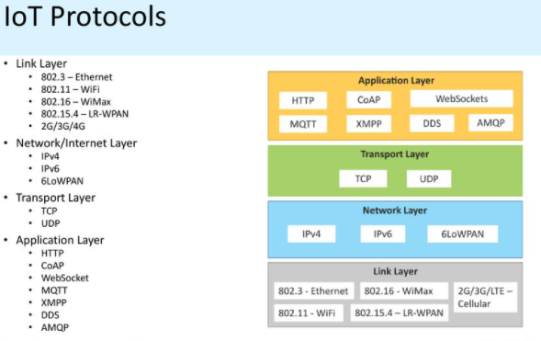
What are IoT Protocols?
We all know that IoT refers to a system of interrelated, internet-connected objects that are able to collect and transfer data over a wireless network without human intervention, which is more like interaction between sensors, devices, gateways, servers and other user applications but what enables all this smart stuff to talk and interact are the IoT protocols which can be seen as languages that the IoT gear uses in order to communicate.
In simple words, IoT protocols are a crucial part of the IoT technology stack without which hardware would be rendered useless as the IoT protocols enable it to exchange data in a structured and meaningful way. Out of these transferred pieces of data, useful information can be extracted for the end user.
As shown in the above picture IoT protocol stack have various layers such as Application, Transport, Network and Link layers. Out of which MQTT protocol comes under the Application Layer.

Slide 9
THE MQTT PROTOCOL :-
MQTT Protocol also expanded as Message Queuing Telemetry Transport Protocol is a lightweight, publish-subscribe network protocol that transports messages between devices. The protocol usually runs over TCP/IP, however any network protocol that provides ordered, lossless, bi-directional connections can support MQTT.
The main reason why this protocol is used is it allows edge of network devices to publish to a broker. Clients connect to this broker, which then mediates the connection between the two devices. Each device can subscribe or register to particular topics.
As discussed earlier MQTT comes under Application Layer Protocols of IoT Protocols. Some other prominent Application Layer Protocols are:-
HTTP(Hyper Text Transfer Protocol)
SMTP(Simple Mail Transfer Protocol)

Slide 10
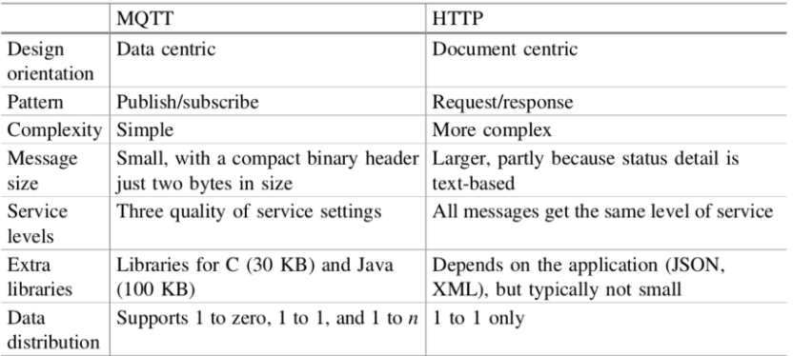
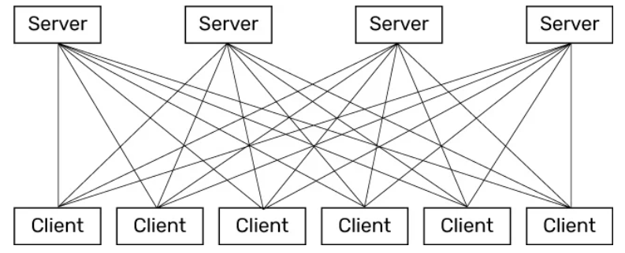
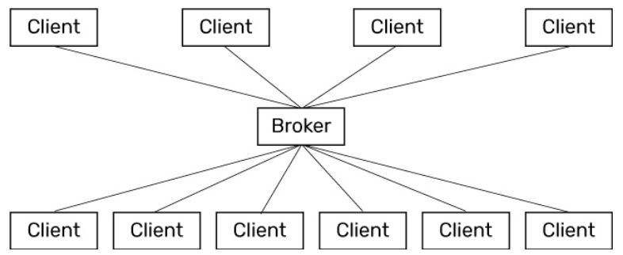
WHY IS MQTT PREFERRED OVER MORE POPULAR HTTP?
For all IoT projects MQTT is preferred over HTTP protocol, because the MQTT protocol follows a pub/subs model which makes it a perfect choice for resource constrained IoT devices, besides which it also provides each client independence in its existence, so that the system keeps working properly even if a glitch occurs at one of the client’s side whereas in a request-response model like in HTTP every client has to interact to servers directly which results in a lot of traffic and eventually making it a slow process with a wastage of lot of battery and time and also a small glitch at one of the clients could break the servers response which makes it not the optimized for the IoT devices.
MQTT responds well to the following needs:-
Minimum Bandwidth use
Operation over wireless networks
Low energy consumption
Good Reliability
Little Processing and Memory resources
Speed and Delivery
Request-Response Model
Pub/Subs Model

Slide 11
IS IT POSSIBLE TO CONTROL THE DEVICES FROM ANY PLCE WITHOUT THE INTERNET ?
The answer is simply NO!
As discussed in the previous slides using the MQTT service providers as brokers we are able to control appliances from any part of the world through INTERNET which in itself can be considered as WAN.
But YES, we can control the appliances without internet, but then we have to be connected to the device through a LAN which could be through a Hotspot, Wifi or a Bluetooth but as you can see, here our range is largely restricted and hence the devices can be operated only within a given range of the network. And from out of that range we cannot have a command over the devices.
And also more importantly in this project we use Ubidots as a broker between the servers and clients which provides us the MQTT service.

Slide 12
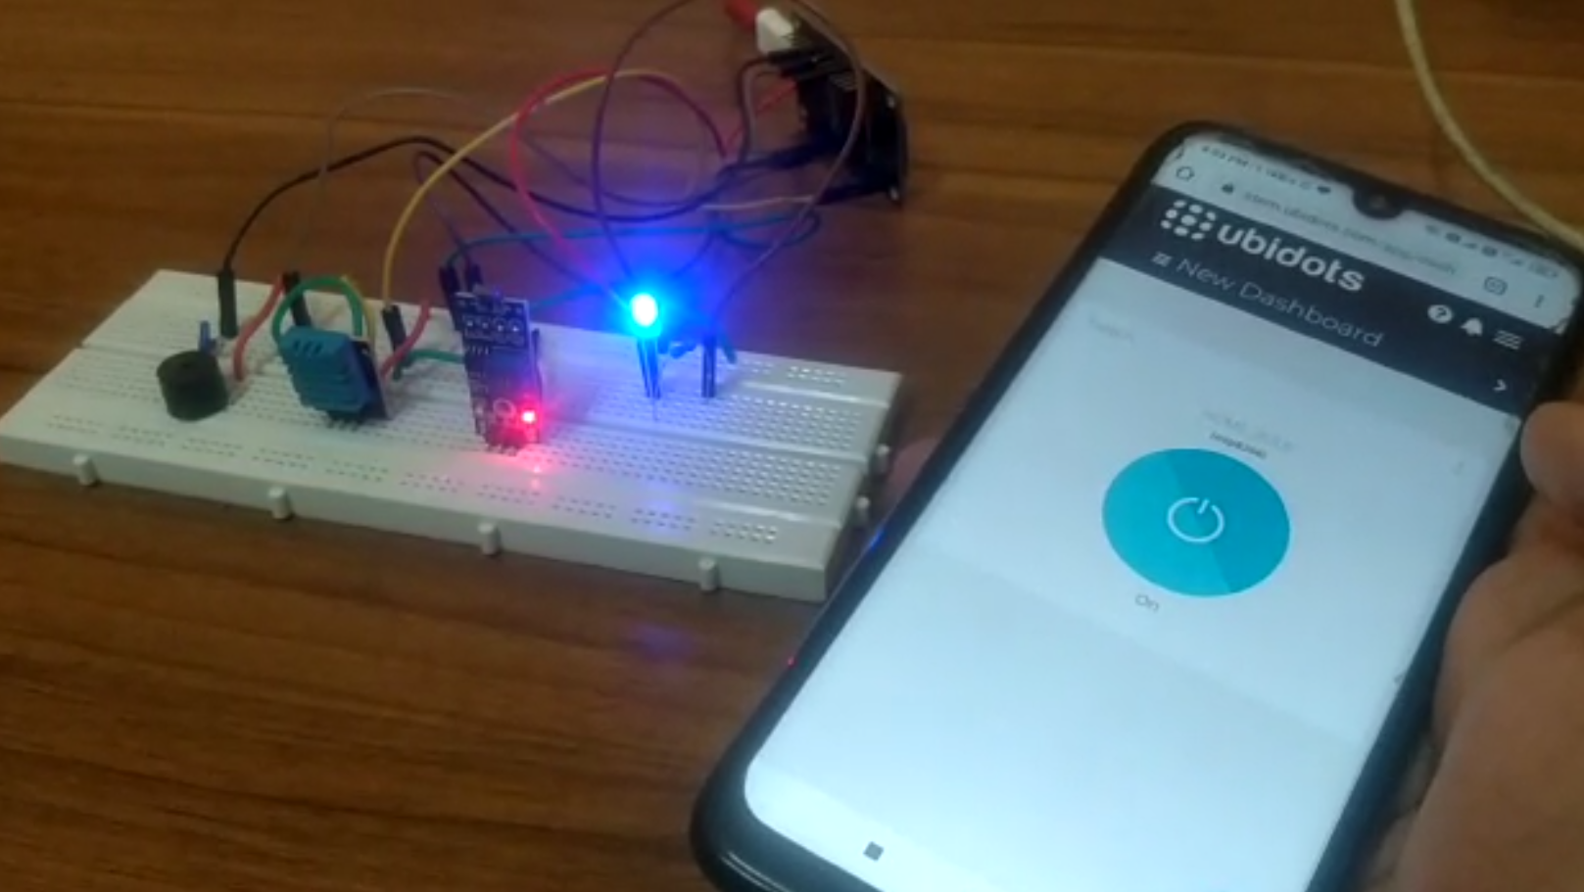
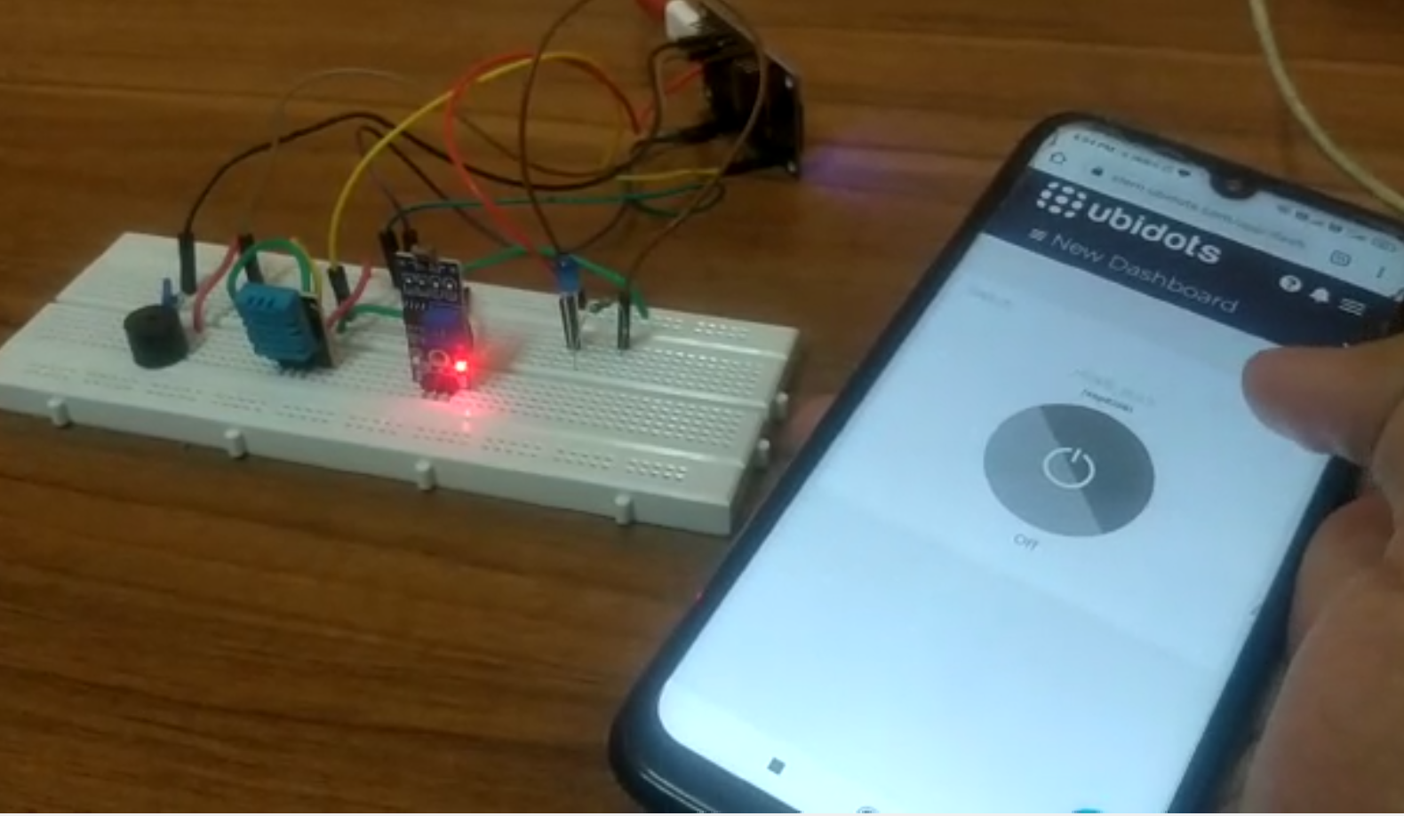
ON MODE OF LIGHT
OFF MODE OF LIGHT

Slide 13
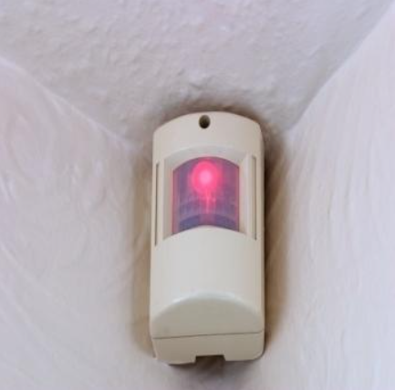
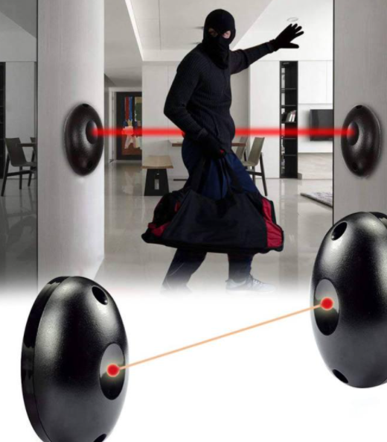
PART 2
AUTOMATIC SECURITY SYSTEMS
Have you ever wondered how automatic security systems as shown in movies work, where there are a lot of alarms which start beeping suddenly when there is a fire accident, a robbery taking place or any other sort of threat at the location to alert all the people in and around the location ?
This part of project would give you a clear idea regarding how automatic security systems notify about the threats at a particular location to all the people at that particular place and also notify the message to related authorities with the threat immediately without any human intervention or action required. And not just reporting such threats but these circuits which we would see also play an important role in automatic doors and research room systems.
BURGLAR ALARM
AUTOMATIC DOOR

Slide 14
WHAT ARE WE DOING HERE EXACTLY?
In this part of the project we are going to use a LDR sensor, which would turn on the alarm in case the light rays falling on it gets interrupted or the light intensity changes suddenly. Also at this point when the alarm starts beeping, which is the electromagnetic buzzer here, the NodeMCU sends me a mail, telling me that the LDR sensor has been interrupted.
In the mail sent to me by the NodeMCU, it also tells to me the current room temperature and relative humidity at the location. And if you look at all these it exactly looks like a mini security system, that is when no one are at house and suddenly some robbers appear at the location with a few torches or flashlights to rob something and then this LDR would interrupt them and also signal you about the threat. The room temperature and relative humidity details are recorded by the DHT11sensor as already discussed above and the mail is sent using SMTP(Simple Mail Transfer Protocol).

Slide 15
THE SIMPLE MAIL TRANSFER PROTOCOL
As already discussed in the previous slides regarding the IoT protocols and various layers of IoT protocols, SMTP is also one such other Application Layer IoT protocol just like MQTT protocol and HTTP protocol.
SMTP or Simple Mail Transfer Protocol is used to send, receive and relay outgoing emails between senders and receivers. When an email is sent, its transferred over the internet from one server to other using SMTP. In simple terms, an SMTP email is just an email sent using the SMTP server.
And just like as in the MQTT protocol we have already seen, even here we will require a SMTP service provider which would act as a broker between the client and the device just like a MQTT service provider so that it can send us the intended mail which the client was expecting.

Slide 16
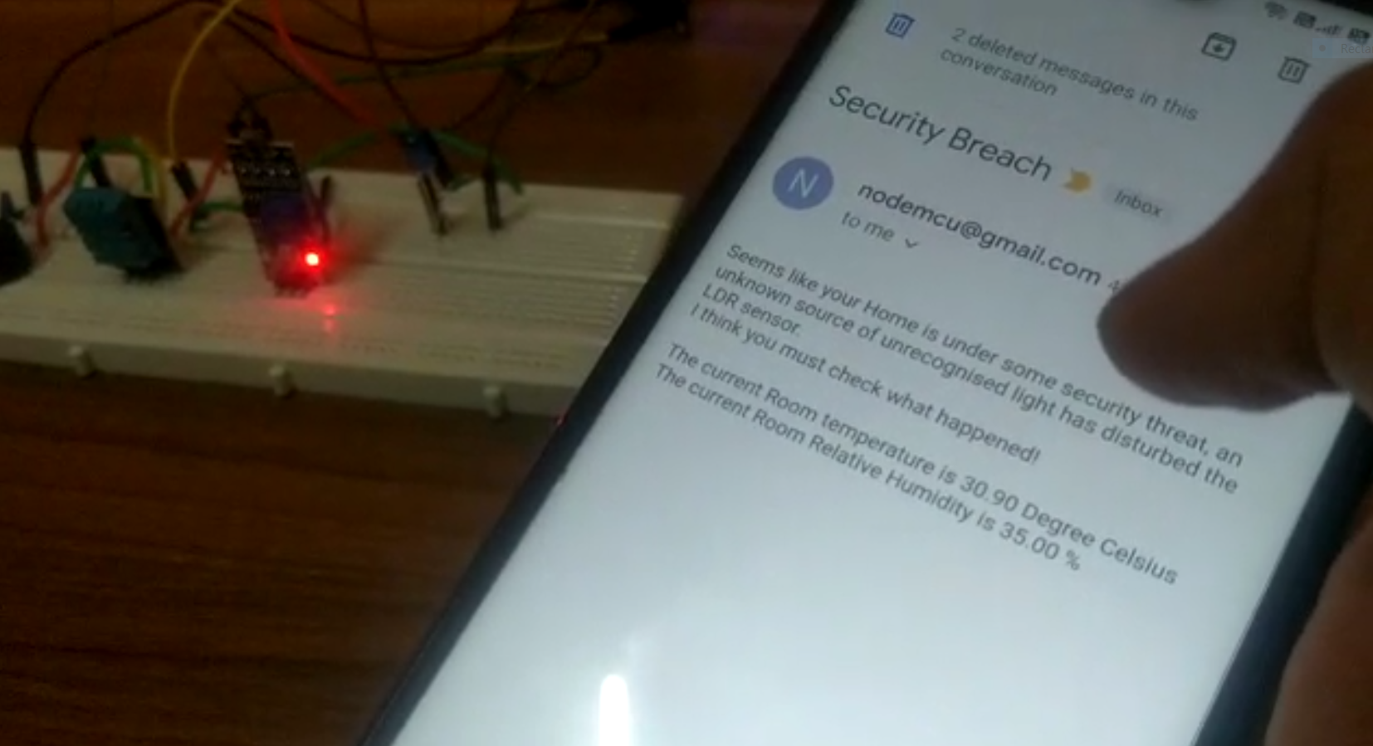
ON THE LEFT YOU CAN FIND THE MAIL I RECEIVED WHEN THE LDR SENSOR WAS DISTURBED

Slide 17
PART 3
AUTOMATIC TRAFFIC LIGHTS SYSTEM PROTOTYPE
In this part of the project we demonstrate a prototype of how a real life traffic systems work, unlike major cities where traffic lights work 24 hours, there are many small cities where traffic light systems work for a limited clock hours and they have to be turned on and off based on timings.
Hence, we have thought to develop a mini traffic light system using LEDs and all the four directions, which can be operated from any place in the world, just like as in part 1, which is a real life application which we see around us everywhere today. In simple words, its practical life application is that we do not have to take the hard work of moving to the location of traffic light system, rather we can switch them on or off from any place based on our requirement.

Slide 18
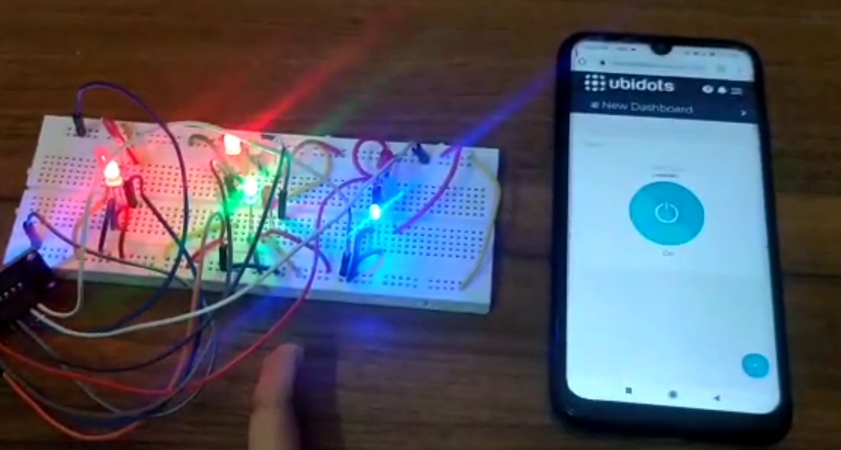
TRAFFIC LIGHT MODEL

Slide 19
THANKING YOU
END OF THE PRESENTATION
TEAM MEMBERS
ARIHANT K R -1901CS09
CHINTMI APPAJI -1901CS17
SPECIAL THANKS TO JIMSON SIR, MY TEAMMATE APPAJI AND ALL THE TAs

